Slide 1
Navigating Financial Aid
Paying for College
Presented by: Sandeep Pannu

Slide 2
Two types of financial aid
Gift Aid
Grants
Scholarships
BOG fee waiver
Self-Help Aid
Loans
Work Study
Employment
Notes:
Refer to Handouts. Mention Pell Grant: need-based

Slide 3
Federal student grants
Pell Grant
Up to $5800
Amount depends on financial need/cost of attendance
Limited to 12 semesters
Federal Supplemental Educational Opportunity Grant
Up to $4,000
For students with “exceptional” financial need (Pell Grant recipients have priority)
Funds depend on availability at college
studentaid.ed.gov
Notes:
95.9% of Pell Grant recipients in 2007-08 had an adjusted gross income (AGI) of $50,000 or less, 3.5% had an AGI of $50,000 to $75,000, 0.4% had an AGI of $75,000 to $100,000 and 0.2% had an AGIof $100,000 or more. But for families with two or more dependent children in college at the same time the percentages drop to 84.4%, 13.5%, 1.3% and 0.8%, respectively. With three or more children in college the percentages drop to 77.2%, 18.8%, 2.7% and 1.3%, respectively. Thus with more children in college at the same time, your chances of qualifying for the Pell Grant increase.

Slide 4
California State grant programs
ANNUAL FAMILY INCOME
$150,000
$120,000
$90,000
$60,000
$30,000
$0
Up to 40% fee reduction*
Cal GRANT A and C Covers up to 100% of tuition/fees**
Cal GRANT B May cover up to 100% tuition/fees and some living expenses***
* When fully funded.
** $90,500 income ceiling, family of four (2016-17).
*** $47,600 income ceiling, family of four (2016-17).
csac.ca.gov

Slide 5
Types of Cal Grants
Type | Where can you use it? | Requirements | What does it pay for?
Cal Grant A | 4-year college | 3.0 GPA, low to middle income | Pays CSU fees. Pays UC fees. Pays up to $9,084 for private colleges.
Cal Grant B | CCC or 4-year college | 2.0 GPA, low income | $1,656 for the 1st year $1,656 + fees for 2nd, 3rd, and 4th years
Cal Grant C | CCC or vocational school | No required GPA | $547 plus up to $2,462 for tuition at a school other than a CCC
FAFSA or CADA & GPA verification by Mar. 2
Notes:
Reference GPA Verification Form/Process

Slide 6
Middle Class “Scholarship”
Based on current CSU and UC system-wide fees, over the next 4 years, maximum awards will be…
Year | Up to | CSU Maximum Award (Fees = $5,472) | UC Maximum Award (Fees = $13,200)
2016-2017 | 30% | $ 1,641.60 | $ 3,960
2017-2018 | 40% | $ 2,188.80 | $ 5,280
csac.ca.gov
Notes:
no less than 10% fee reduction for families with incomes between $100,001 and $150,000.

Slide 7
“Institutional” grants
UC Blue and Gold
Covers tuition/fees for 4 years CA resident
Family income < $80,000
CSU State University Grant (SUG)
Covers university fees each year (~ $5,472/yr.)
CA resident
Family EFC = $4,000 or less
californiacolleges.edu
Notes:
CSU SUG is for those not getting CalGrant first year out (CalGrant B) with Family EFC of $4000 or less.

Slide 8
CHAFEE Grant
Award up to $5,000
Current or former foster youth
In-care between 16 & 18 years old
Haven’t reached age 22 by July 1st of award year
www.chafee.csac.ca.gov

Slide 9
Scholarships
May require applications beyond FAFSA and Dream Act
Additional aid for “Dreamers” (e4fc.org)
To find scholarships, check with…
High School Counselor / Career Center
Local Community / Businesses
Colleges / Universities
Web: www.finaid.org collegeboard.org/pay fastweb.com californiacolleges.edu studentaid.ed.gov
SCAM ALERT!
Never pay money to get scholarships for college!

Slide 10
Board of Governor’s Fee waiver
BOG Fee Waiver (California Community Colleges)
Completely waives $46/unit fee for classes
Meet income standards ($35,775 family of four, 2014)
Receiving TANF, SSI/SSP, or General Assistance
Have financial need, based on FAFSA or CA Dream Act app of $1,104 (as of 2015-16)
icanaffordcollege.com

Slide 11
EOP / EOP&S Programs
Educational Opportunity Programs (CSU)
Up to $2,000/yr. EOP grant
Extended Opportunity Programs and Services (CA Community Colleges)
Book vouchers
Transportation passes and bus permits
Parking passes
Free tutoring
Additional applications required!

Slide 12
Student loans
Subsidized (need-based, best)
Unsubsidized (next best)
Parent PLUS Loans
Private (be careful!)
studentaid.ed.gov
Notes:
Refer to Handout

Slide 13
Federal Work study program
Part-time job (on/off campus)
Usual offer $2,000-$5,000 a year
Say “YES” to Work Study on FAFSA – (you can decline the offer later)
studentaid.ed.gov

Slide 14
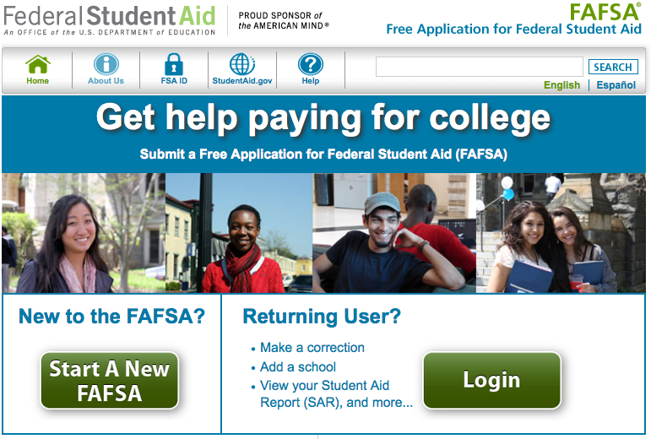
application process
FAFSA
www.fafsa.gov
or
CA Dream Act App
dream.csac.ca.gov
Apply between Jan. 1st and Mar. 2nd Renew every year (starting in Oct.)

Slide 15
which appLICATION do I use?
FAFSA
US Citizen
Permanent Resident
DREAM ACT
AB 540 or AB 2000
DACA SS#
Private Universities: Check with FA office about additional applications (e.g., CSS/PROFILE) & deadlines.
Notes:
CSS/PROFILE - $25 first app, $16 every app thereafter

Slide 16
What do the applications do?
College Plans – Cost of Attendance (COA), incl. direct and indirect costs
Family Financial Info – Expected Family Contribution (EFC)
COA – EFC = Financial Need

Slide 17
EFC Examples
 | American River College | Sacramento State | UC Davis | St. Mary’s College
COA | $11,426 | $22,804 | $32,168 | $57,956
- EFC | $1,000 | $1,000 | $1,000 | $1,000
= Financial Need | $10,426 | $21,804 | $31,168 | $56,956
Notice: EFC does not change

Slide 18
CSU sample award offer
COA: $24,000
- EFC: $4,000
= Need: $20,000
Cal Grant A: $5,500
Pell Grant : $5,500
Subsidized Loan: $4,000
Unsub. Loan: $3,000
Work Study: $2,000
Total Award: $20,000

Slide 19
student dependency status
You are a dependent student unless:
Age 24 or older
Married or have a child
Veteran of armed forces
Since age 13: parents deceased, in foster care, ward of the court, or legally emancipated
Unaccompanied minor or homeless determine by school district
In court appointed legal guardianship
Dependent students must report Parent Info/Signature on FAFSA / Dream Act app

Slide 20
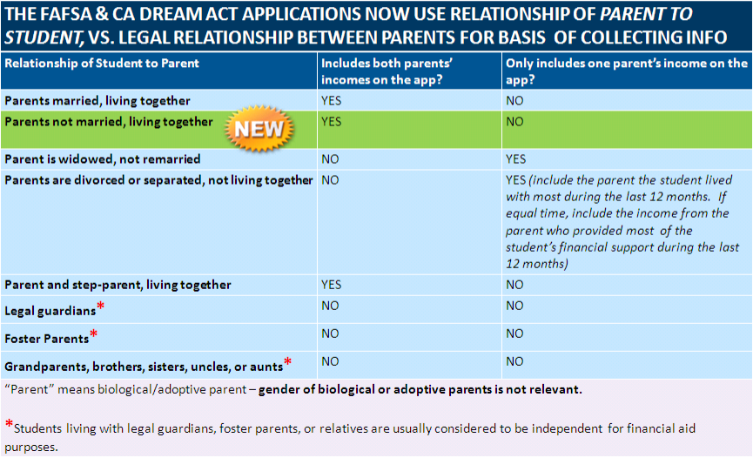
Definition of a “parent”

Slide 21
Signing the fafsa or cada
FAFSA
Requires two signatures for dependent student (student + parent)
FSA ID replaces PIN
Can print/mail signature for parents who don’t have SS#
CADA
Requires two signatures for dependent student (student + parent)
Parent signs with PIN after student completes application
Keep PIN secure!

Slide 22
steps in the application process
Apply between Jan. 1st and Mar. 2nd (renew each year starting in Oct.)
Two signatures (Student and Parent) required for dependent students
Verify Cal Grant GPA submission
Colleges download info from FAFSA / Dream app
Colleges meet need (grants, loans, institutional aid, and work-study)
Students notified of award (college web-portal)

Slide 23
after submitting your application
You and the colleges you list receive Student Aid Report (SAR)
Review your SAR for errors and make corrections
Create WebGrants 4 Students account
Colleges may request additional documentation or select student for verification
www.fundyourfuture.org
Notes:
Refer to Checklist (FAFSA or CADA)

Slide 24
Where to get help?
Cash for College Workshops
January-February 2016
Financial aid experts for review/support
For students and parents
www.scoe.net/calsoap
Notes:
Refer to Flyer

Slide 25
WHAT TO BRING TO THE WORKSHOP?
If available…
Student’s Social Security card and drivers license/gov’t issued ID
If not a US citizen, bring alien registration card
Parents Social Security card
Parent’s federal income tax return or W-2s from tax year 2015 (or 2014 to estimate)
Records of untaxed income (e.g., child support, TANF, interest income, veterans non-educational benefits, Social Security benefits)
Student’s W-2s and/or pay records
Bank account statements or records
Records of investments (stocks, bonds, etc.)
Business records
List of colleges you are interested in

Slide 26
summary of aid & applications
FAFSA www.fafsa.gov
Pell Grant
Cal Grants
Middle Class Scholarship
Institutional Grants / Scholarships
BOG Waiver
Federal Loans
Dream Act dream.csac.ca.gov
Cal Grants
Middle Class Scholarship
Institutional Grants / Scholarships
BOG Waiver
Apply between Oct. 1st and Mar. 2nd
Renew every year Oct.1st—Mar. 2nd

