Slide 1
California State University (CSU)

Slide 2

CSU Admissions Requirements

Slide 3
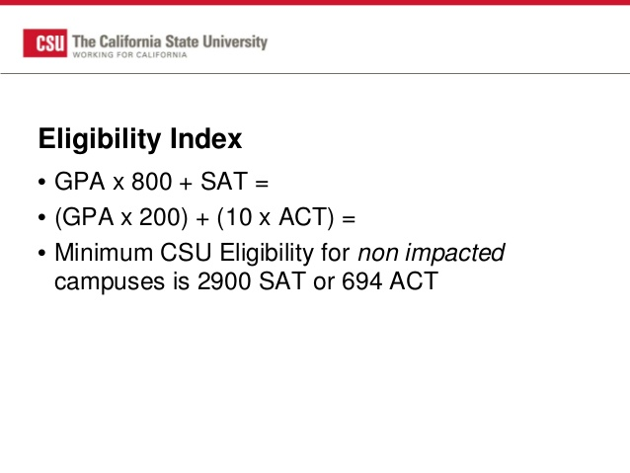
Requirements Cont.

Slide 4
Admitting Using Eligibility Index
Bakersfield
Channel Islands
Dominguez Hills
East Bay
Maritime Academy
Stanislaus
*Sacramento

Slide 5
Impacted In All Majors
Fresno
Fullerton
Long Beach
San Diego
San Jose
San Luis Obispo
-Must complete application by November 30th
⁻Applications are open Now
csumentor.edu

Slide 6
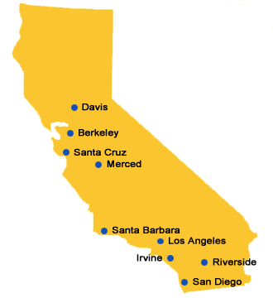
University of California

Slide 7
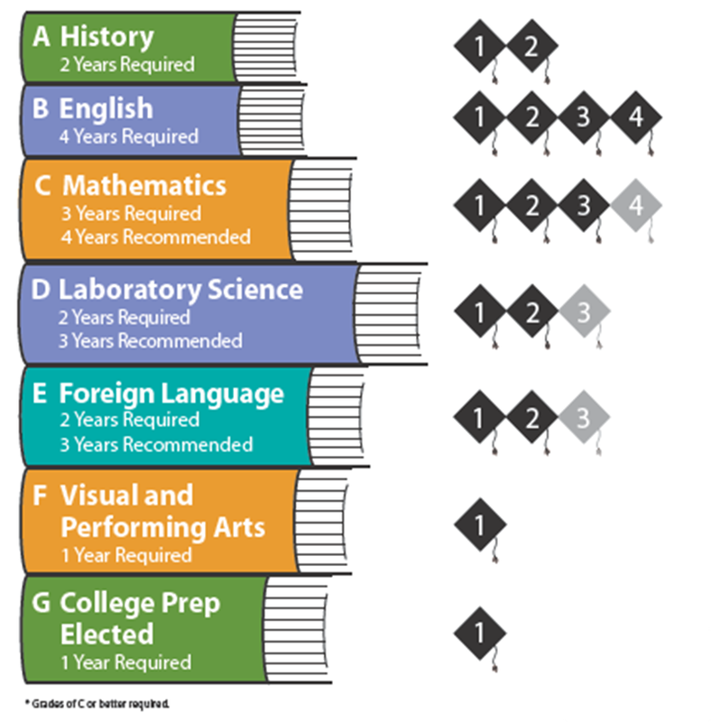
UC Requirements

Slide 8
UC Requirements Cont.
Must take SAT OR ACT Exams by December 2016
Must have at least a 3.0 grade point average in academic courses (a-g courses)
Complete 4/8 of the personal insight questions

Slide 9
Requirements Cont.
# of a-g courses
ELC status
Strength of senior year
Outstanding performance in a subject(s) area
Leadership skills or any other special skills
Special projects within high school curriculum
Location of high school
Must file for admission by November 30th
Applications are open NOW
Universityofcalifornia.edu

